Slide 1
Honey Bee Health Analyses of reasons and preventions for high risk colony losses
Nonparametric Statistics Project
TEAM MEMBERS
Marta Cerri
Luca Mainini
Lupo Marsigli
Eugenio Varetti

Slide 2
Goals of the project
North American apiarists saw a dramatic decline in their honey bee colonies in last decade. When this phenomenon is particularly intense, we refer to it as “Colony Collapse Disorder”. Numerous causes for CCD have been proposed, but no single stressor alone seems to be responsible for the malady*.
Our objective is to understand possible precautions that would allow beekeepers to reduce future bee losses, as acting on stressors interactions or moving the colonies to new states depending on the season.
* Honeybee Veterinary Medicine, Vidal-Naquet, 2018
Notes:
Large-scale losses have occurred in previous years and the entity of lost seemed to be .

Slide 3
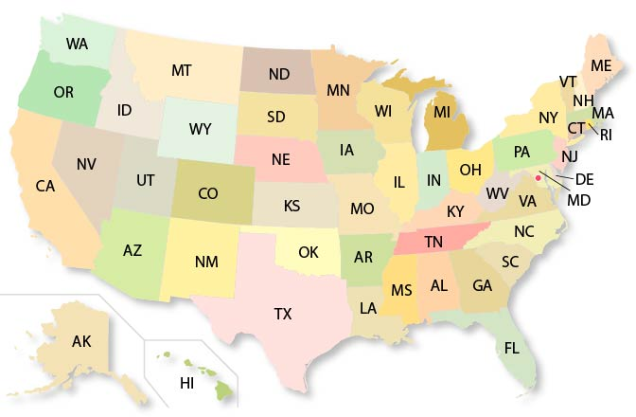
Dataset Description
Number of colonies
Number of colonies at the beginning of the quarter
Q1: January - March
Max number of colonies
Colonies plus all colonies moved into that state during the quarter
For each state in US:
Colony lost
Percentage and absolute values of colony lost
Q2: April - June
YEAR
from 2015 to 2022
Colony added
Colony that was either created or purchased
Q3: July - September
Colony renovated
Number of surviving colonies that were renewed
Stressors
Percentage of colonies affected by different types of stressors (1 feature each)
Q4: October - December
Diseases
Pesticides
Other
Varroa mites
x

Slide 4
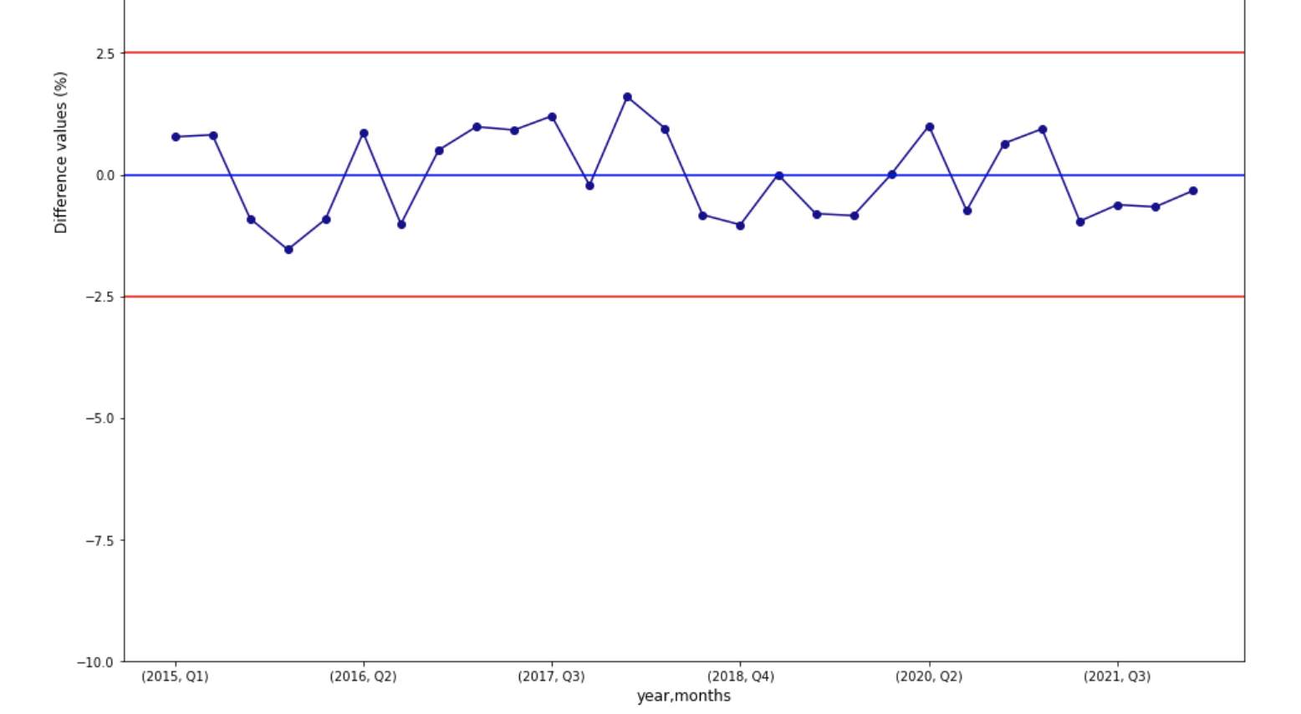
Understanding the data
Assuming no colonies were moved out of state
Max colonies – Lost Colonies + Added Colonies = Beginning Inventory of next quarter
If no colonies are moved out of state, then the calculation above should be within 2% of the starting inventory of the following quarter. These small differences are mainly due to memory errors or miss of precision in filling out the survey.
Pollinating colonies are moved from state to state throughout the year following the crops that need to be pollinated. Therefore, the maximum number of colonies in a state can vary widely during a quarter and throughout the year.
US data: differences between computed colonies at the end of the quarter and beginning inventory of next quarter
x
Notes:
Data are obtained through a survey
While some colonies in the U.S. are primarily honey producing colonies and usually remain in one state, other colonies are primarily used for pollination purposes. Pollinating colonies are moved from state to state throughout the year following the crops that need to be pollinated. Therefore, the maximum number of colonies in a state can vary widely during a quarter and throughout the year. For example, on an individual record level an operation could not have any colonies in North Dakota at the beginning of a quarter because all of their colonies are in California for almond pollination. But during the middle of the quarter the almond pollination season ends and the colonies are moved back to North Dakota.

Slide 5


Additional Data
Average
Maximum
Temperature
Minimum
Drought
PDSI
Possible explanatory factors
Precipitation
PM 10
Pollution
PM 2.5
Air Quality Index

Slide 6
X
1. DATA EXPLORATION

Slide 7
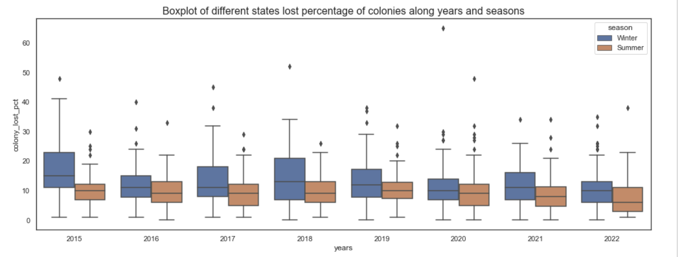
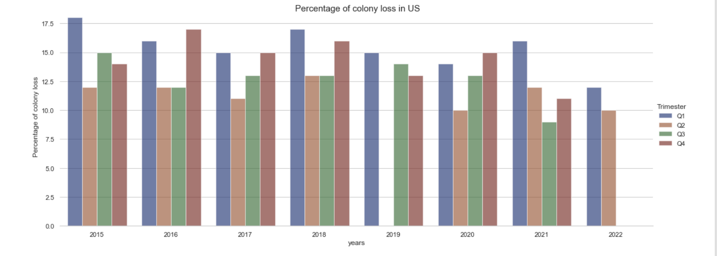
Analysis of «abnormal» periods
Paired two population test in each year:
Significance difference at 5% between summer and winter in the following years:
2015, 2016, 2017, 2018, 2021, 2022
Notes:
First of all, we wanted to find out if there was a season or a year where the loss of colonies was particularly high.
Later, we will try to understand what generated these significantly higher losses
In particular, we performed a LOCAL PERMUTATIONAL TEST FOR DIFFERENCE IN COLONY LOST PCT POPULATION BETWEEN SUMMER AND WINTER

Slide 8
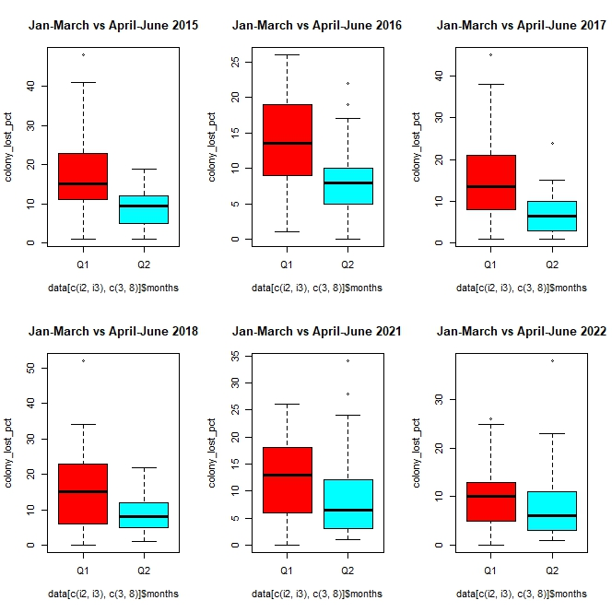
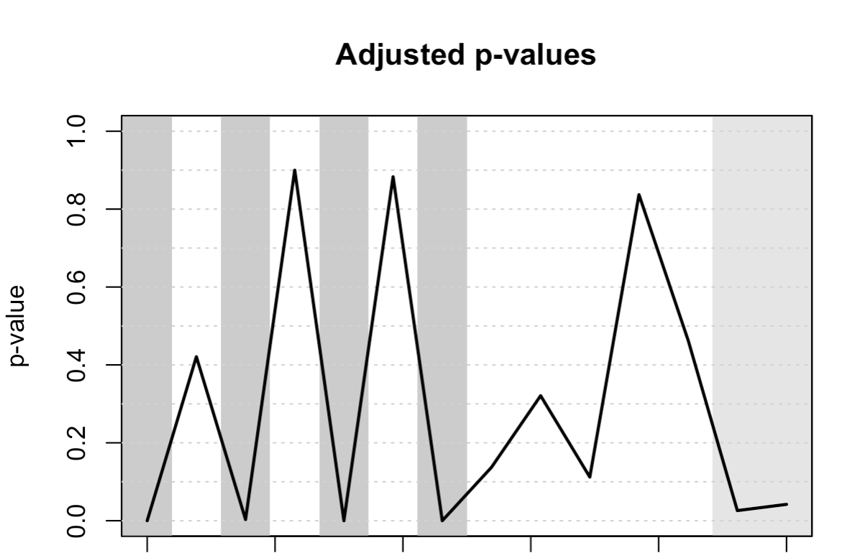
Analysis of «abnormal» periods
Global Permutational test for functional data: statistical evidence of difference in distribution between summer and winter.
Interval-wise testing:
Time
Local permutational test for difference in colony lost % between summer (functional data Q2-Q3) and winter (funtional data Q4-Q1)
Losses are higher in the quarter Q1 rather than in Q2 [performing a two-sample paired permutation test on only these quarters]
Notes:
First of all, we wanted to find out if there was a season or a year where the loss of colonies was particularly high.
Later, we will try to understand what generated these significantly higher losses
In particular, we performed a LOCAL PERMUTATIONAL TEST FOR DIFFERENCE IN COLONY LOST PCT POPULATION BETWEEN SUMMER AND WINTER
We can see in grey the years where there is high statistical evidence that the losses are different
On the left, we can see the boxplot of these years for the first 2 quarters
Performing a two-sample paired multivariate permutation test on only these years, there is statistical evidence to state that the loss is higher in the quarter Q1 (January-March) rather than in Q2 (April-June)

Slide 9
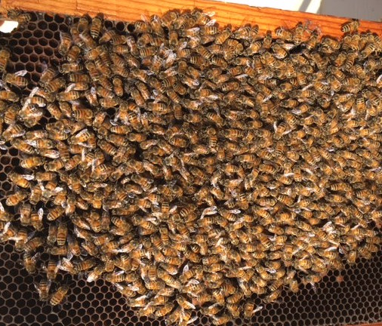
Cold winters DO NOT kill a healthy colony
According to our first analysis, winter is the season where bees are most at risk, but not only for the cold. Indeed, as soon as the temperature drops to below 10°C, bees come together to form what is known as the “winter cluster” (allowing them to stay at 25-30°C).
Colonies are lost during the winter due to viruses, parasites (as Nosema Apis) and diseases. Some of these virus are related to Varroosis. If the infestation by Varroa Mites is high at the beginning of winter and nothing is done to decrease it, their chances of survival can dramatically drop.
Other winter problems can be pesticide build up in stored pollen, starvation or a failed queen.
Notes:
The winter cluster becomes tighter and more compact as the ambient temperature drops further. Regardless of weather conditions, the temperatures within the winter cluster stay very warm at ca. 25-30°C.

Slide 10
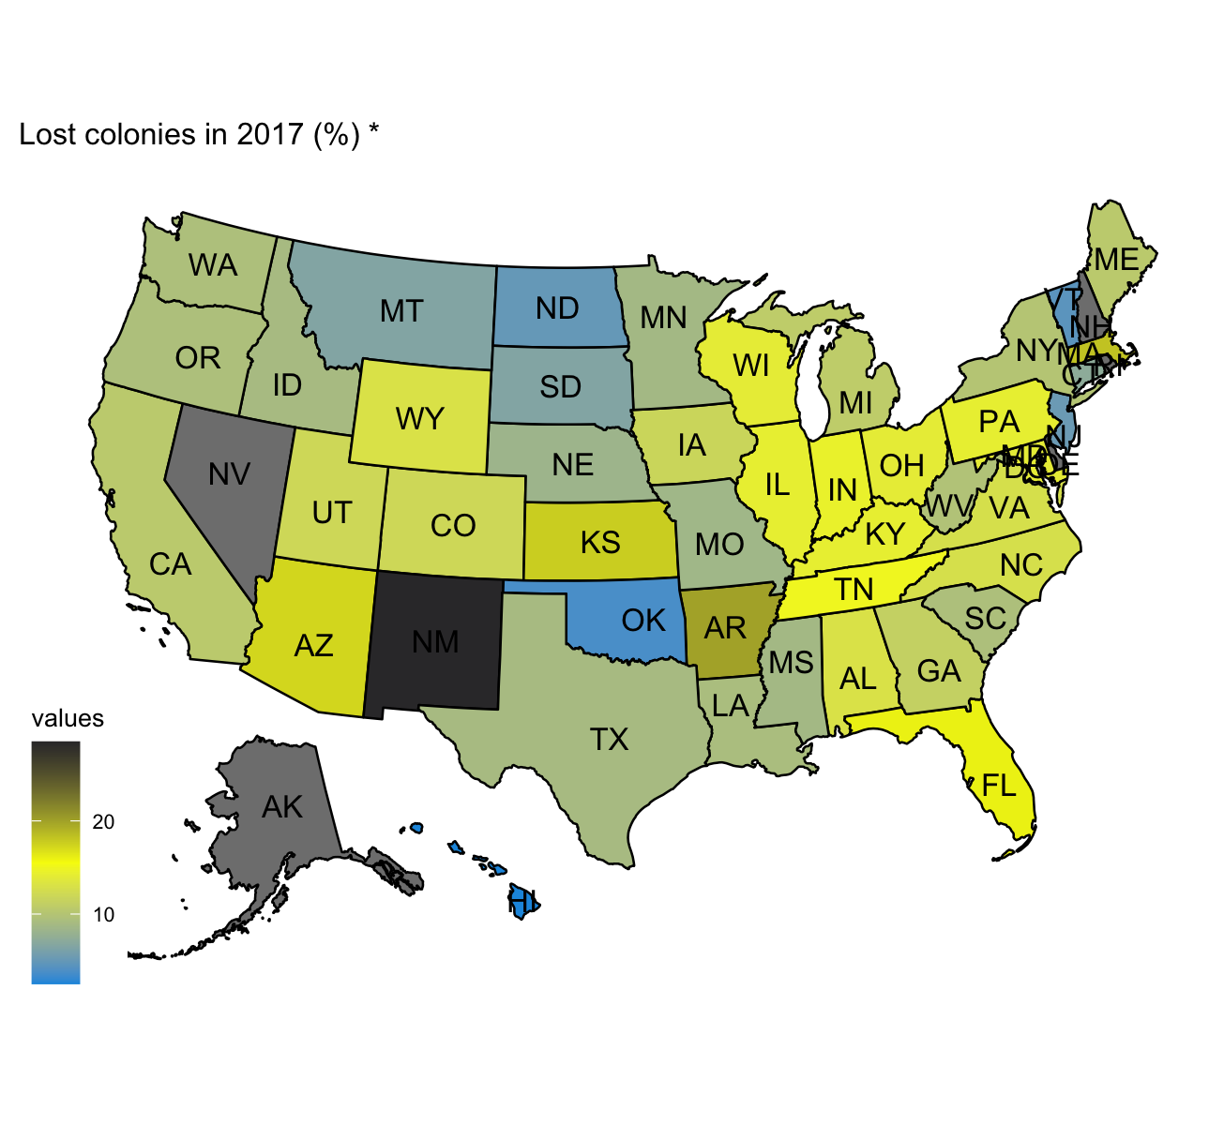
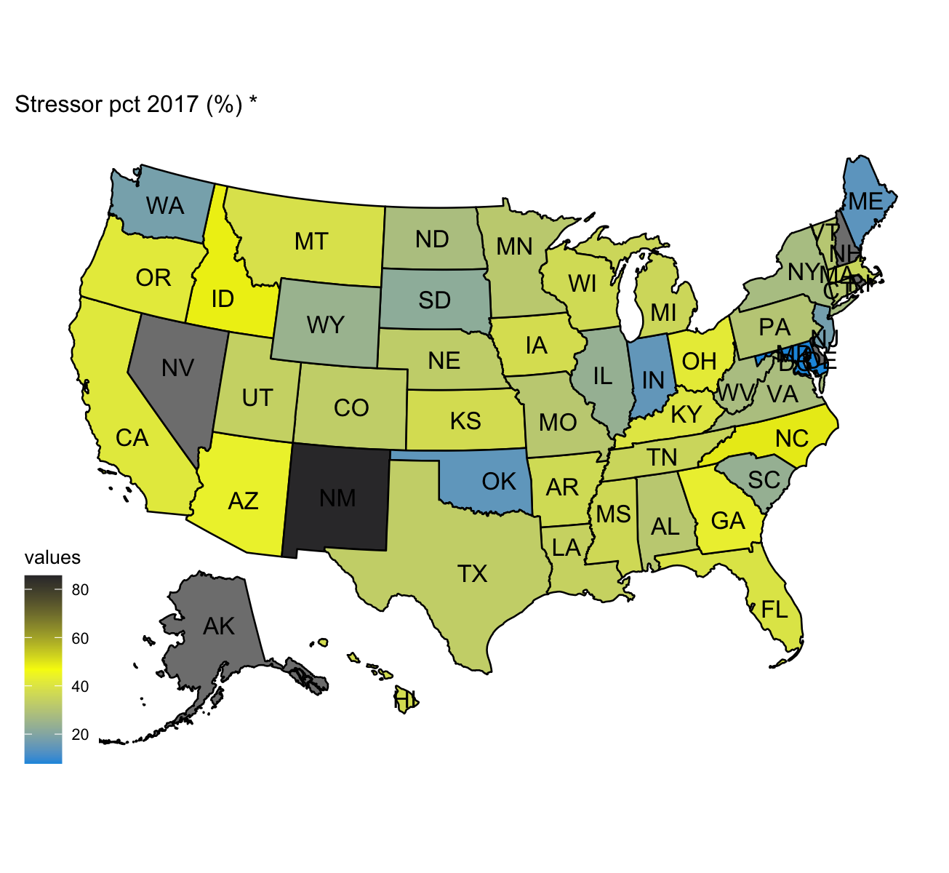
Are colonies losses correlated with Stressor?
Varroa Mites

Slide 11
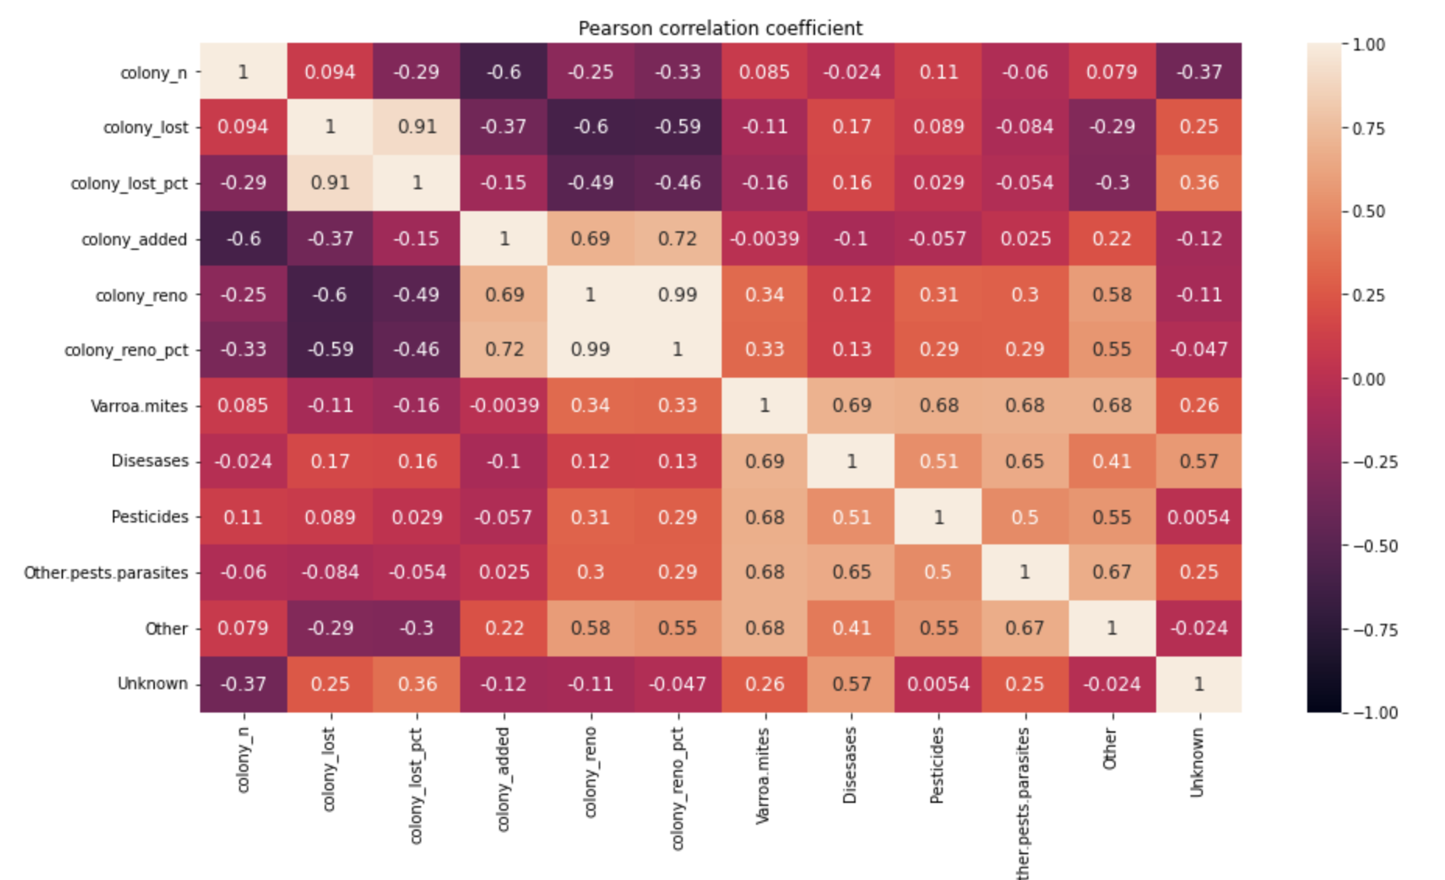
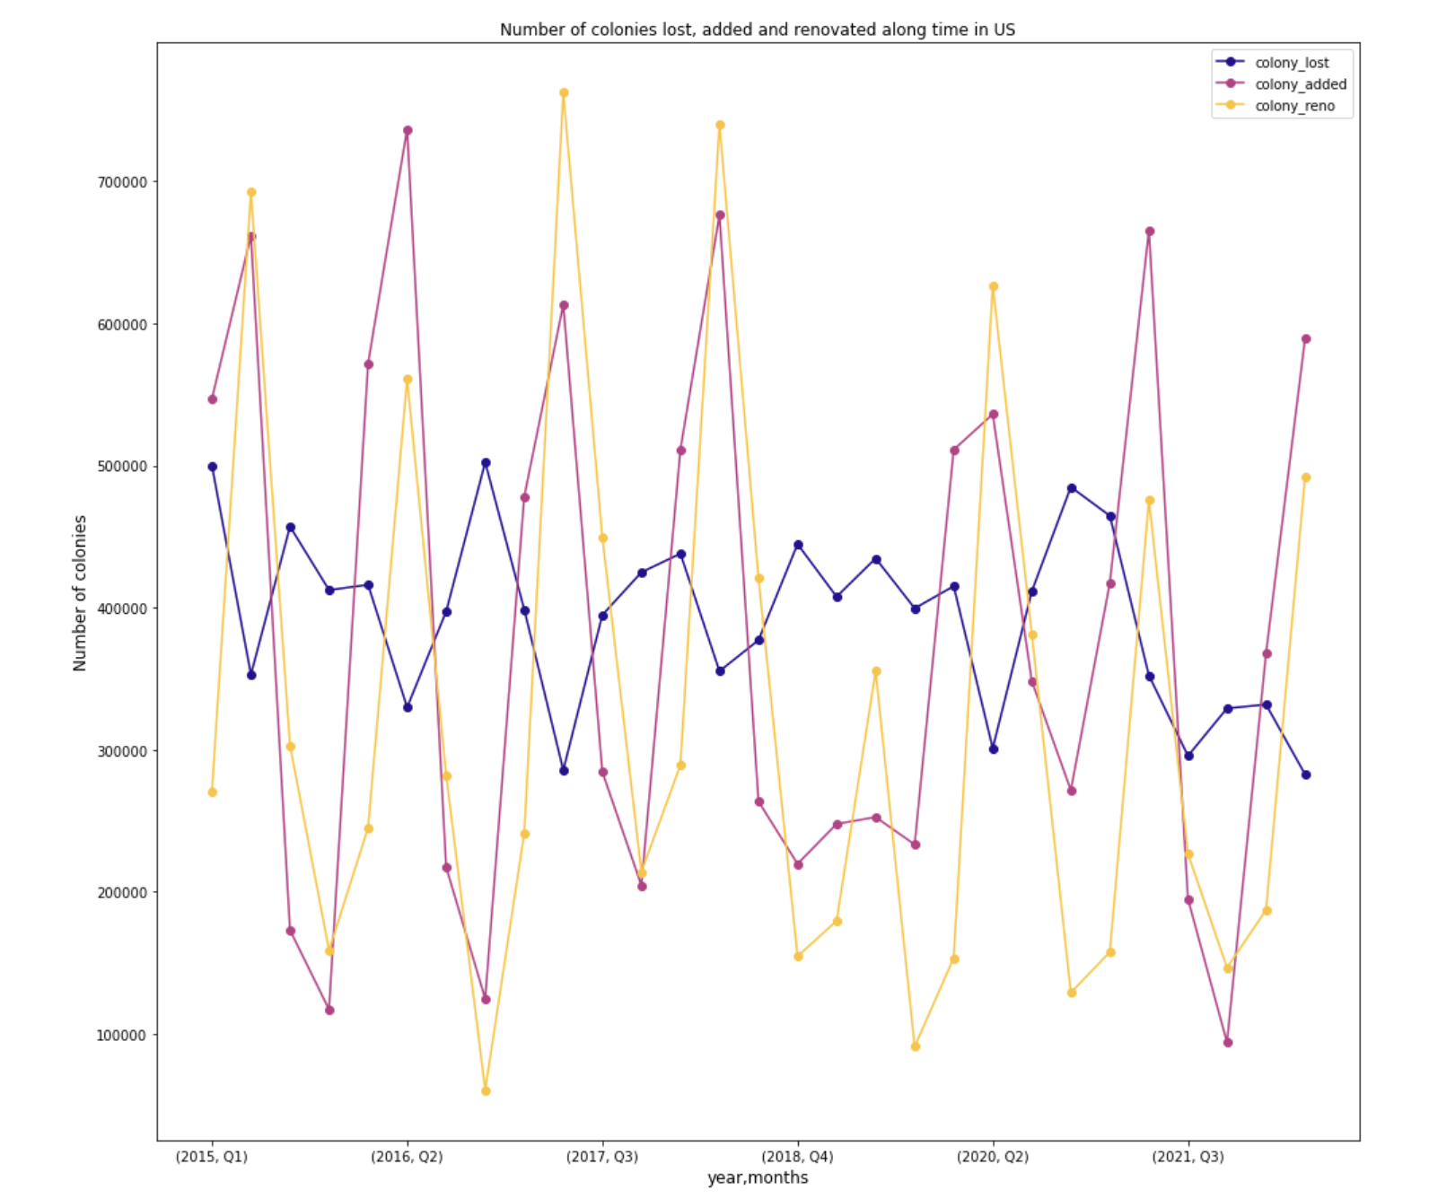
American colonies losses are correlated with Stressor

Slide 12
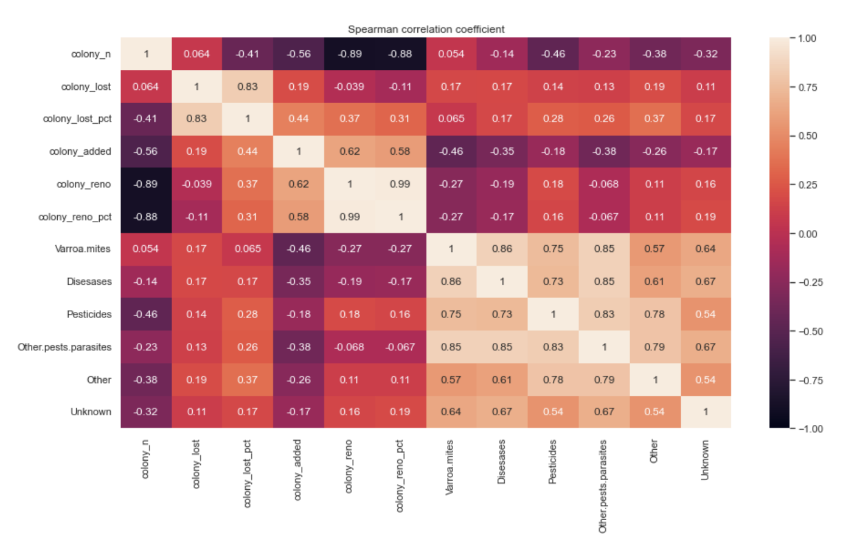
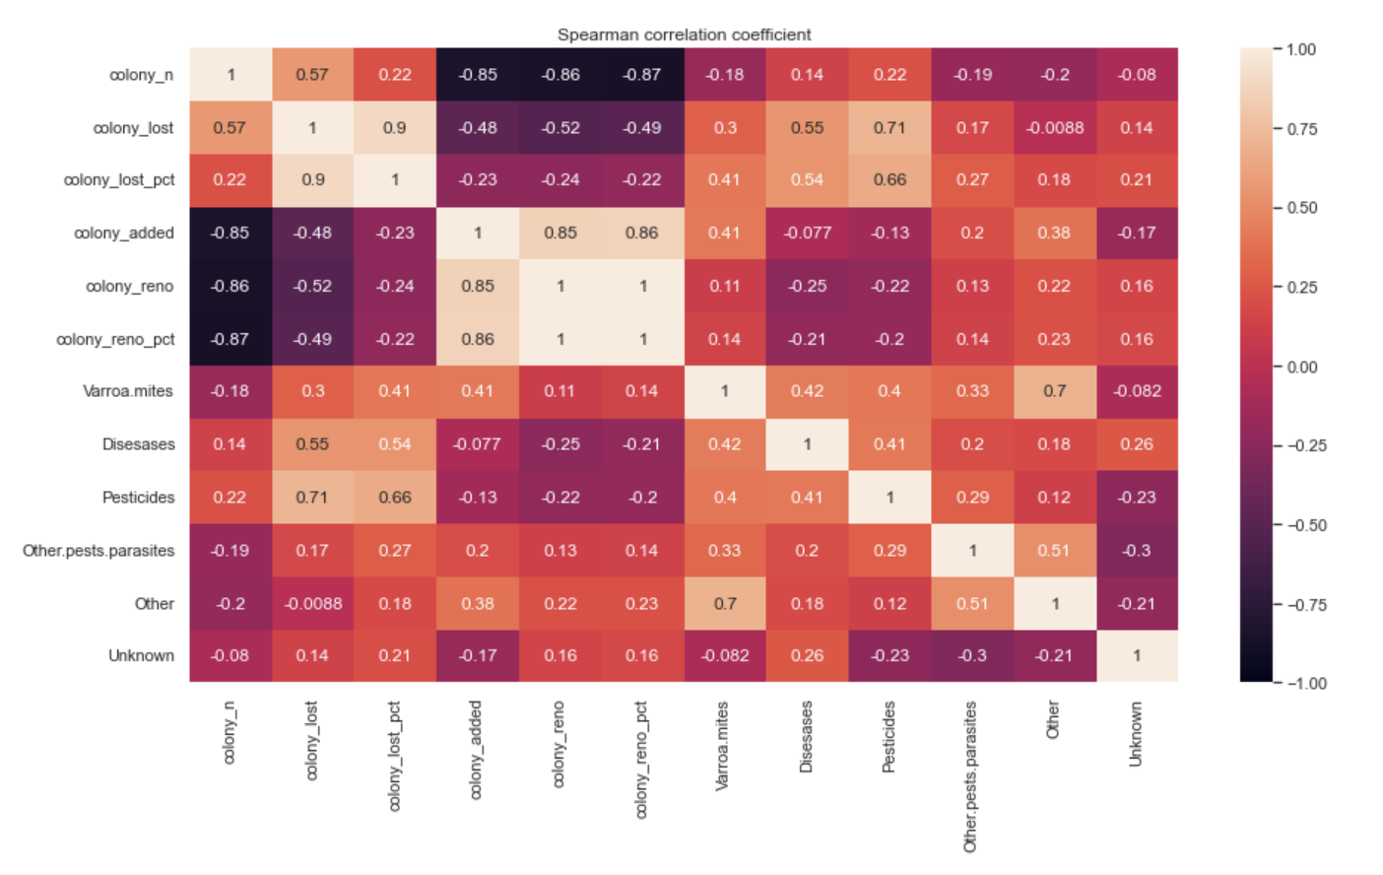
Spearman correlation – Winter - US
Spearman correlation – Summer - US
Notes:
In general, Spearman Correlations are not too high between stressors and colony lost pct.
The reasons might be different:
the effect of stressors might be lagged, meaning that the presence of stressors can influence on the losses in the following quarters and not necessarily just in the same quarter the stressors are detected
The values report the nonlinear influence of each single stressor on the loss percentage. As said at the beginning, none of them is the only reason of loss, but we know that their effects might be coupled and this is going to be studied in the regression model.

Slide 13
Pesticides and Diseases are strongly correlated with Summer US colony losses (%)
Notes:
However, considering summer, Pesticides and Diseases are strongly correlated with Summer US colony losses

Slide 14
Spearman correlation – Winter - US
Spearman correlation – Summer - US
Varroa mites infestation is correlated with the presence of diseases, other parasites and pesticides
Notes:
In addition, we can see a general correlation between stressors, especially during summer
Varroa mites infestation is correlated with the presence of diseases, other parasites and pesticides

Slide 15
Spearman correlation matrix
Functional data of states:
- Ordering with Modified Hypograph Index -
Median function of «unknown» stressor over the years seems to follows the pattern of the median of colony loss %
Notes:
functional correlation we catch also longitudinal non-linear patterns in time, and here we see an higher coefficient for the correlation of colony loss percentage with the single stressors, in particular with unknown.
Each state represents a function over time
Spearm correlation matrix is computed with Modified Hypograph Index (MHI)

Slide 16
Varroa destructor: the most devastating honey bee pest
*
Notes:
The Varroa mite is the world’s most devastating honey bee pest.
Varroa is a highly efficient vector of honey bee viruses and drives changes in virus distribution, prevalence, and virulence.
Colonies with low infestation generally show very few symptoms, however as the mite population increases symptoms become more apparent. Heavy Varroa mite infestations can build up in 3–4 years and cause scattered brood, crippled and crawling honey bees, impaired flight performance, a lower rate of return to the colony after foraging, a reduced lifespan and a significantly reduced weight of worker bees. Colony symptoms, commonly called parasitic mite syndrome, include an abnormal brood pattern, sunken and chewed cappings and larvae slumped in the bottom or side of the cell. This ultimately causes a reduction in the honey bee population, supersedure of queen bees and eventual colony breakdown and death.

Slide 17
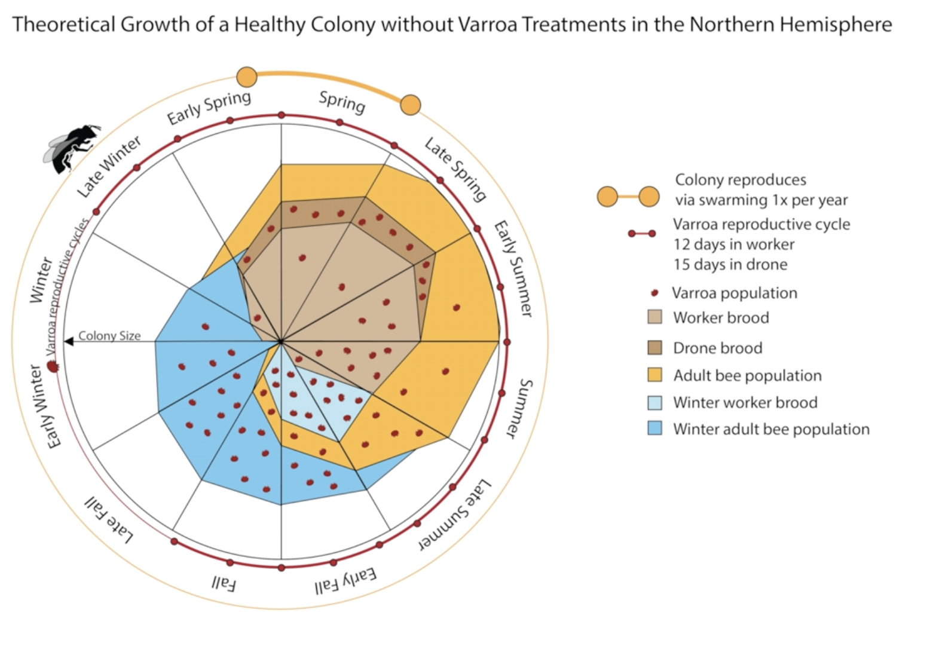
Varroa destructor: the most devastating honey bee pest
*
Varroa is a highly efficient vector of honey bee viruses and drives changes in virus distribution, prevalence, and virulence.
Heavy Varroa mite infestations can build up in 3–4 years
* Varroa destructor: A Complex Parasite, Crippling Honey Bees Worldwide, Kirsten S.Traynor et Al.
Notes:
The Varroa mite is the world’s most devastating honey bee pest.
Varroa is a highly efficient vector of honey bee viruses and drives changes in virus distribution, prevalence, and virulence.
Colonies with low infestation generally show very few symptoms, however as the mite population increases symptoms become more apparent. Heavy Varroa mite infestations can build up in 3–4 years and cause scattered brood, crippled and crawling honey bees, impaired flight performance, a lower rate of return to the colony after foraging, a reduced lifespan and a significantly reduced weight of worker bees. Colony symptoms, commonly called parasitic mite syndrome, include an abnormal brood pattern, sunken and chewed cappings and larvae slumped in the bottom or side of the cell. This ultimately causes a reduction in the honey bee population, supersedure of queen bees and eventual colony breakdown and death.

Slide 18
Influence of Varroa
Some states show similar patterns in overwintering reductions of bee colonies and number of stressed colonies by Varroa mites.
Outliers detection
Shape outlier: New Mexico
Notes:
Some states show a correlation between reductions in overwintering honey bee populations and Varroa mites
As we showed in the previous plots and is mentioned in literature, Varroa Mites is the most dangerous and most present stressor in bee colonies. We tried to explore and understand from a qualitative point of view if it really impacts the colony loss drastically more than the other stressors, and indeed we found some states in US with similar patterns in overwintering reductions of bee colonies and number of stressed colonies by Varroa mites. You can see in the plot the trends in New Mexico, the state with the highest peaks in colony loss which correspond to the highest peaks in Varroa.
This plot may anyway lead to the conclusion that Varroa Mites can always influence the loss by itself, which is against what is said in literature: “no single stressor alone seems to be responsible for the malady”.
And indeed this is confirmed by the Outliergram on the right: the case of new Mexico is a special one, this state is the only shape outliers detected studying the functional data of colony loss percentage, so it has a trend and phase variability which is unusual compared to the majority of states in US.
These analyses confirm that we cannot rely only on Varroa impact but we will need to study the combined effects that the stressors can have on the colony loss with a regression model.

Slide 19
2. ANALYSES OF CLIMATE INFLUENCE ON BEE’S HEALTH
X

Slide 20
Clustering states in 3 zones
Cluster 1: Alpine
Cluster 2: Continental
Cluster 3: Subtropical/ Mediterranean
Functional clustering by average temperature
Notes:
Functional clustering by univariate (fda cluster)
Purple is more or less related to subtropical or Mediterranean climate
Green to Continental
Orange to Alpine climate

Slide 21
% stressed by Varroa in groups
Notes:
(clust. By avg)
Data suggests that 1.varroa mites strike more warmer countries
2. raised seasonal temperatures reinforce autumn Varroa destructor infestation in bee colonies

Slide 22
Varroa winter infection in the different climate groups

Slide 23
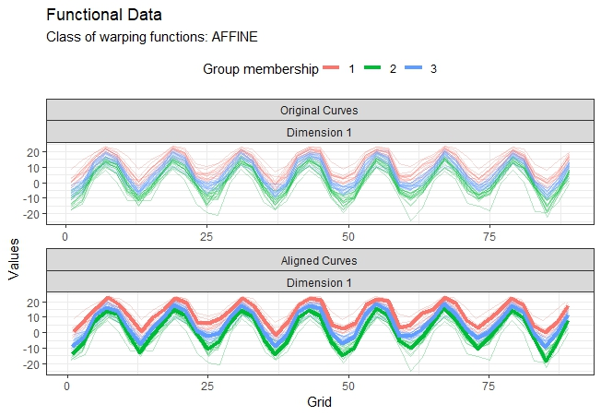
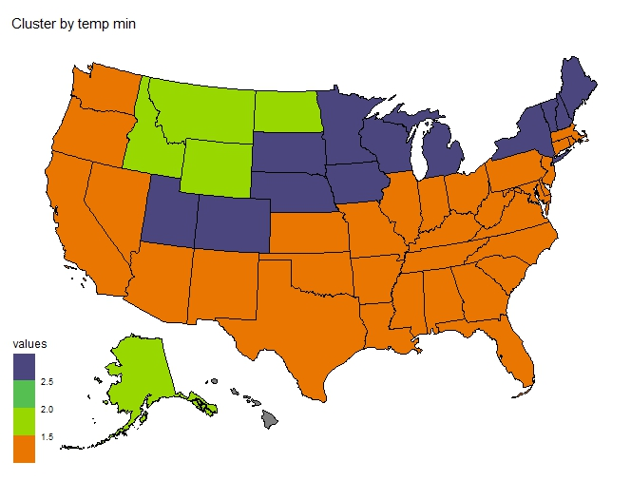
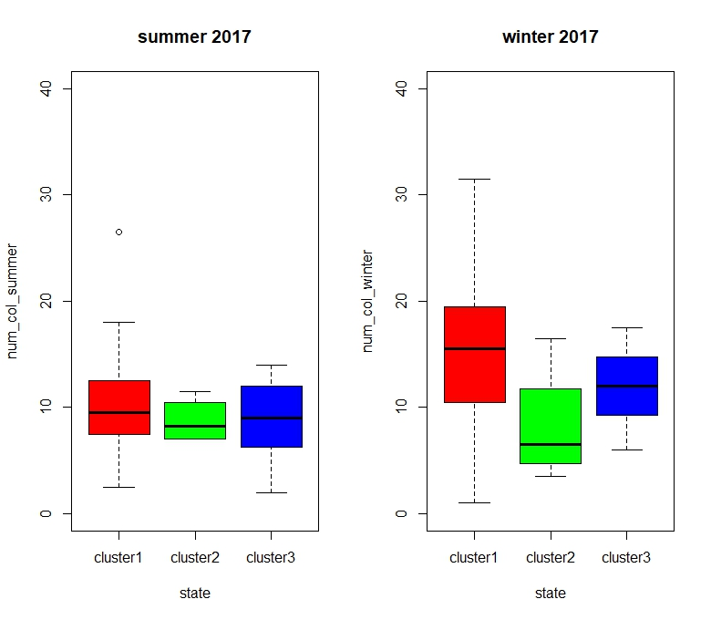
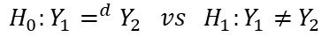
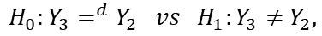
Cluster states into groups based on their climate
Cluster 1:Subtropical/ Mediterranean
Cluster 2: Alpine
Cluster 3: Continental
PERMUTATIONAL ONE-WAY ANOVA: Does the cluster by temp-min have an impact on the colony loss?
HYPOTHESIS: For each year we consider data (different states) in clusters as independent and identically distributed.
For all the winters, we have significance difference between the clusters, so we can perform 2 population tests:
$$H_{0}:Y_{3}=^{d}Y_{2} vs H_{1}:Y_{3}≠{ Y}_{2},$$
$$H_{0}:Y_{1}=^{d}Y_{2} vs H_{1}:Y_{1}≠{ Y}_{2}$$
Notes:
ANOVA (permutational test)
ANOVA : does the cluster by temp min have an impact on the colony loss?
H0:τi=0 ∀i vs H1:∃τi≠0 i∈{1,2,3} The anova is significant if we consider just the quarter with low temperatures.
we can state that the loss of bees is lower in the cluster with the lowest temp min

Slide 24
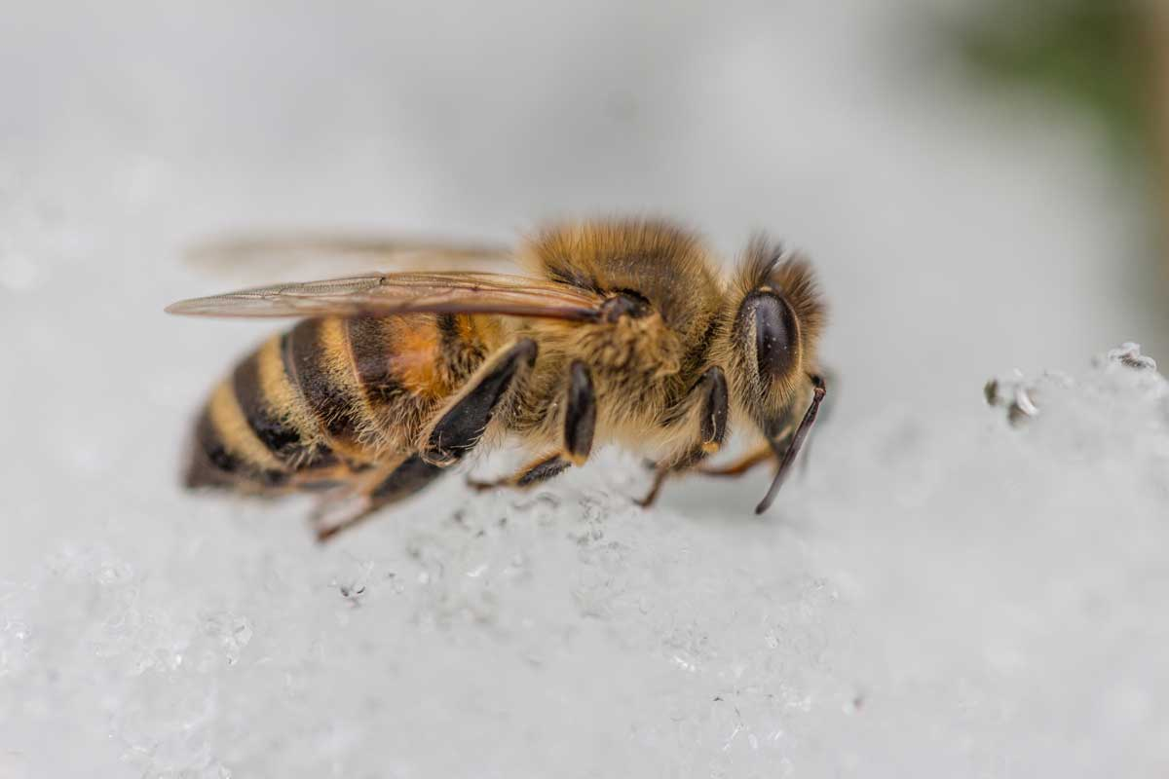
Extreme events and bee health
Previous researches showed that:
¹During late autumn, cold spells with adequate duration and intensity trigger colony wintering at the right time, reducing the likelihood of colony loss over winter.
²During winter, regular snaps of warm weather help bees to leave the hive and defecate. The more regular these mild winter weather conditions occur, the better the hygiene of the hive can be maintained
Mattila HR, Otis GW. 2007 Dwindling pollen resources trigger the transition to broodless populations of long-lived honeybees each autumn.
Sparks TH, Langowska A, Głazaczow A, Wilkaniec Z, Bieńkowska M, Tryjanowski P. 2010 Advances in the timing of spring cleaning by the honeybee Apis mellifera in Poland

Slide 25
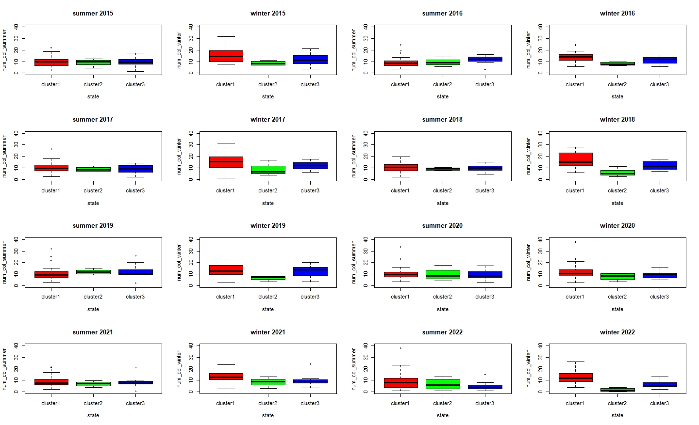
% losses in groups - winter and summer
Notes:
Autunno: se sono troppo caldi, le api sono troppo attive -> stacncano e consumano provviste e quindi inverni stanchi senza provviste
Inverno: se ci sono un po' di giorni caldi meglio così le api possono andare fuori e mantenere pulito alveare -> ridotto rischio di infezioni
- Cluster by temp min

Slide 26
Spearman correlation matrix
 | Colony lost pct | temp mean | temp max | temp min | precipitations
Colony lost pct | 1.00000000 | 0.3241109 | 0.3553618 | 0.2643499 | -0.03560824
temp mean | 0.32411093 | 1.0000000 | 0.9688404 | 0.9837818 | 0.58896067
temp max | 0.35536178 | 0.9688404 | 1.0000000 | 0.9155325 | 0.40713594
temp min | 0.26434992 | 0.9837818 | 0.9155325 | 1.0000000 | 0.68301644
precipitations | -0.03560824 | 0.5889607 | 0.4071359 | 0.6830164 | 1.00000000
Notes:
Non la mettiamo

Slide 27
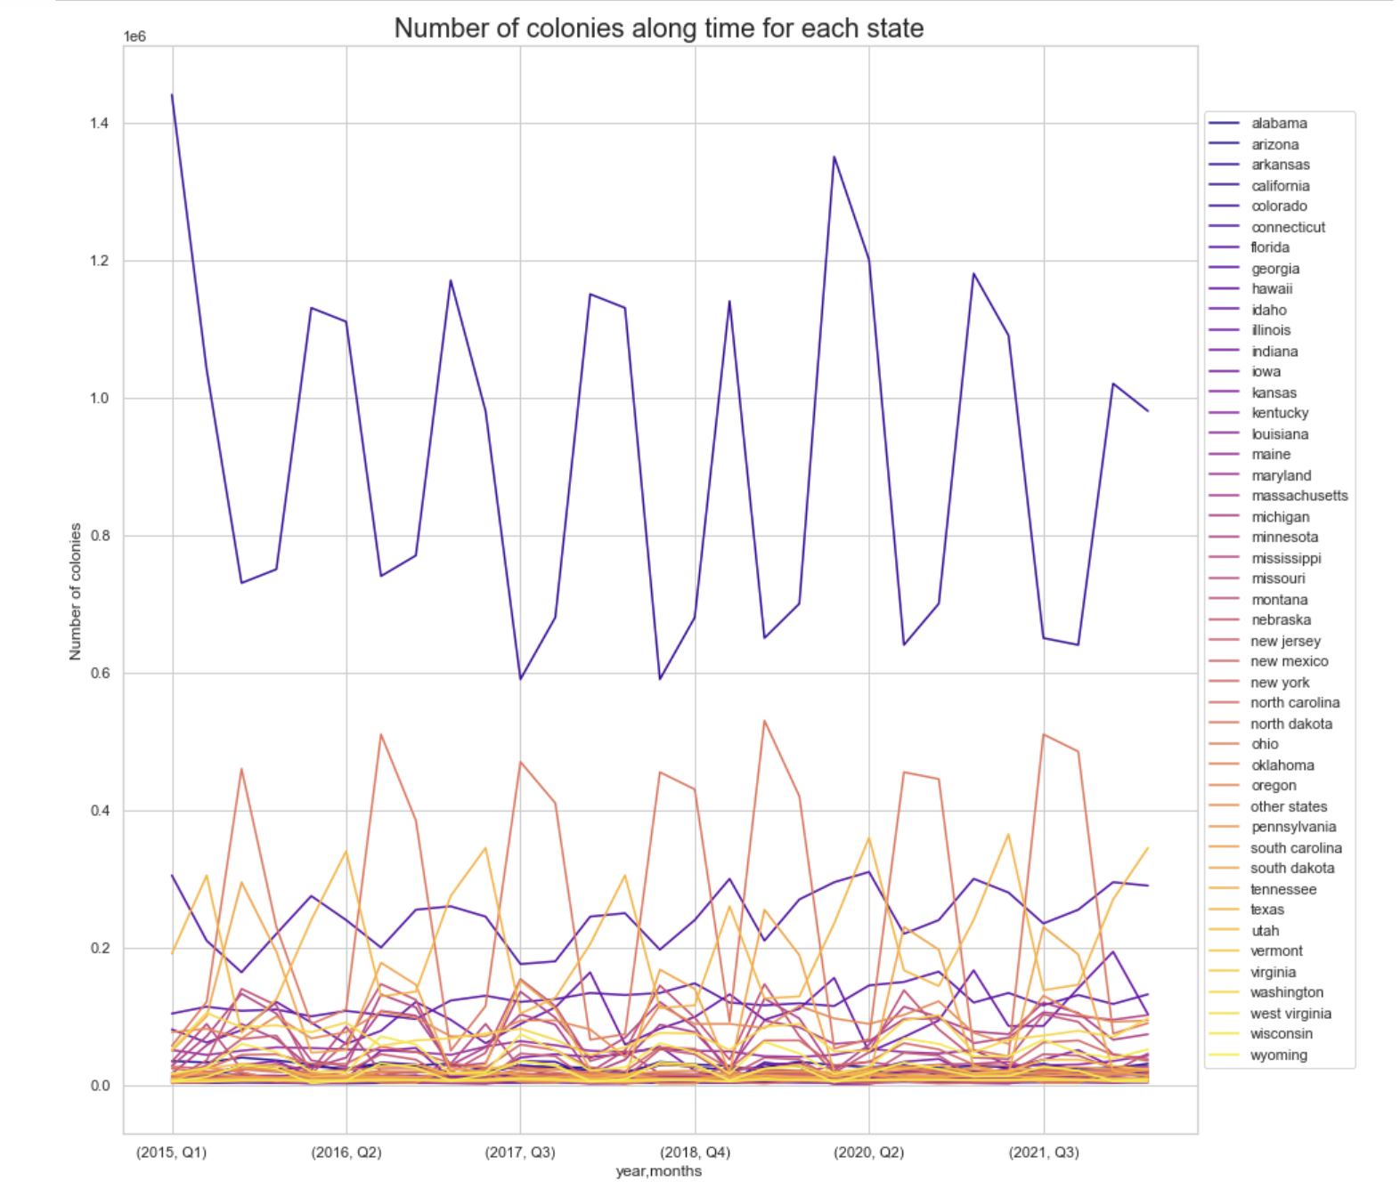

Slide 28
3. A REGRESSION MODEL

Slide 29
X
3. A REGRESSION MODEL

Slide 30
Semiparametric Regression
Parametric part:
We need interpretability
Non-parametric part:
Tensor-product space⊗time (using thinplate splines and fourier-basis)

Slide 31
NEXT STEPS AND POSSIBLE IMPROVEMENTS
Functional outlier detections: curves need to be smoothed. Not even registered to check amplitude outliers.
Missing values for 2019-Q2: fit a SARIMA model to retrieve this information and perform functional data analysis.
Try other clusters by climate zone already performed by other users.
Conformal prediction to predict future values and understand possible precautions that can be taken.
Survival Analysis using cumulative percentage decrease along semesters and considering as "event of death" when the decrease is below 10%.
Notes:
Conformal prediction: stimare andamento futuro dell’andamento di morte
Survival Analysis: check the cumulative percentage decrease in the population and as event of death we consider when this decrease goes below 10%.

Slide 32
THE END

